Slide 1
Pharmacy Best Thomas Bisset
7:15 Welcome and introductions
7:20 Changes to the Pharmacy Contract 2023/24
7:35 HRT: Prepayment Certificate
7:50 Maximizing Advance Services
8:05 Managing Repeat Prescription Workload
8:25 Stock Shortages
8:35 Questions
Pharmacy BEST
April 2023

Slide 2
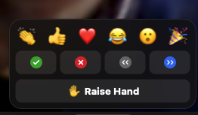
Housekeeping
Introductions
Mute
Questions

Slide 3
Pharmacy BEST: Aims & Objectives
Barnsley Education Support & Training
Best.barnsleyccg.nhs.uk
Help Pharmacies deliver quality services
Align with ICB Barnsley place plans
Help Barnsley patients access healthcare in the appropriate place, at the appropriate time from the appropriate person

Slide 4
BEST website
https://best.barnsleyccg.nhs.uk

Slide 5
Pharmacy Contract 2023/24

Slide 6
Year 5 CPCF services cannot go ahead without funding uplift
Monday 13th March 2023
PSNC has today told Ministers that NHS England and the Department of Health and Social Care (DHSC) must not roll out any new or expanded services or a Pharmacy Quality Scheme in 2023/24 unless extra funding is put into community pharmacies.
NHSE communications directing more patients to pharmacies also need to stop, and the DHSC should consider putting caps on existing Advanced Services to protect core dispensing funding.
Community pharmacies are in a desperate position with the outlook continuing to deteriorate.
Without an urgent injection of extra funding there is not enough money to pay for the current services and dispensing being done by the sector; let alone for new things to be rolled out.
Instead, the focus needs to be on supporting community pharmacies to meet the day-to-day needs of patients and on building on the advice that we already offer to the public via a fully-funded Pharmacy First scheme.

Slide 7
Services and the Pharmacy Quality Scheme (PQS)
There will be a phased rollout of service extensions and of a new service – the Pharmacy Contraception Service (PCS) – with key rollout and launch dates as follows:
11th January 2023: Launch of the initial tier of the new PCS – please note, the service will now not start on 11th January 2023 as originally planned, but it is expected to commence in early 2023;
March 2023: Expansion of the CPCS to include referrals from Urgent and Emergency Care settings;
19th April 2023: Expansion of the NMS to include anti-depressants; and
4th October 2023: Launch of the second tier of the PCS.
DHSC and NHS England have also agreed that no further new services will be introduced or expanded within the current CPCF funding envelope.
Notes:
PQS has been agreed but not published.
Likely to be along the same lines as last year

Slide 8
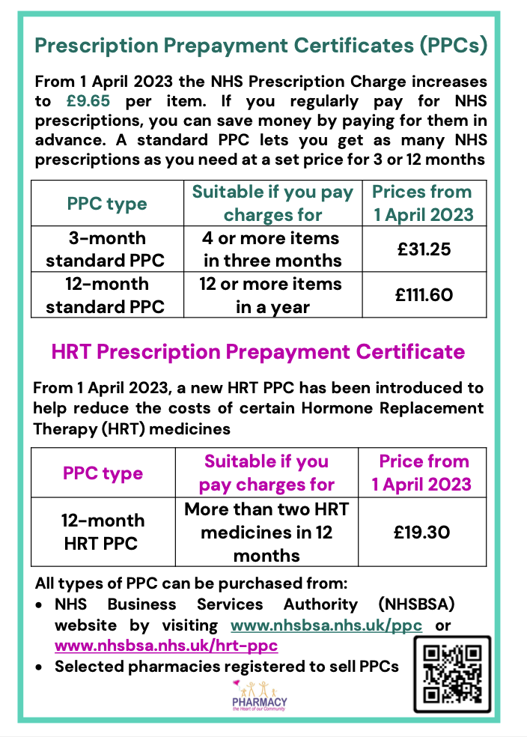

Slide 9
HRT Prescription Prepayment Certificate

Slide 10
HRT PPC on MYS

Slide 12
HRT – Mixed scripts
The new regulations give 3 options to contractors/pharmacists facing mixed prescriptions presented by patients with an HRT PPC:
First, refuse to dispense a mixed prescription issued to the patient – refuse to dispense both the listed HRT item and the other medicine – and ask the patient to return to the GP for two separate prescriptions.
Second, either:
dispense the listed HRT item (the patient or the patient’s representative signing to claim the HRT prescription exemption), or
dispense the other non-HRT medicine(s) with the prescription charge(s) paid.
(This may be appropriate if the patient has an urgent clinical need for the HRT item or other medicine) The patient will need to obtain another prescription for any items not dispensed.
Third, dispense both the listed HRT item and the other medicine – and complete an FP57 refund form for the HRT item and charge for the other medicine.
Notes:
As a consequence of its limited scope, a patient with an HRT PPC will continue to pay the prescription charge for any other (non-HRT) medicines (unless another exemption reason applies). While GPs will be required to write HRT items on separate prescriptions, on occasion both an HRT item and another medicine will be prescribed on the same prescription– a mixed prescription. This presents a problem for a patient who has an HRT PPC because a prescription cannot be processed as both ‘exempt’ and ‘paid’ within the NHS prescription processing and pricing systems.

Slide 13
HRT

Slide 14
Advanced Services
Community Pharmacy Consultation Service
Hypertension Case Finding
Notes:
If you are unable to deliver a service

Slide 15
Community Pharmacy Consultation Service
NHS 111
NHS 111 on line
GP Roll out plan
A&E from April
Promote around a specific condition eg Hayfever

Slide 16
GP – CPCS: Warm Handover

Slide 17
GP – CPCS: Warm Handover

Slide 18
GP – CPCS: Warm Handover

Slide 19
GP – CPCS: Warm Handover

Slide 20
Pharmacyfirst Revisited

Slide 21
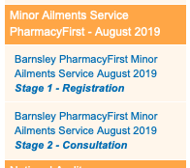
PharmacyFirst

Slide 22
PharmacyFirst

Slide 27
Aciclovir 5% cream 2 gram
Allevia 120mg tablets (Sanofi) 15 tablet
Allevia 120mg tablets (Sanofi) 30 tablet
Allevia 120mg tablets (Sanofi) 7 tablet
Anbesol teething gel (Alliance Pharmaceuticals Ltd) 10 gram
Anusol cream (Church & Dwight UK Ltd) 23 gram
Anusol Plus HC suppositories (Church & Dwight UK Ltd) 12 suppository
Anusol Soothing Relief suppositories (Church & Dwight UK Ltd) 12 suppository
Aspirin 300mg dispersible tablets 32 tablet
Benadryl Allergy One A Day 10mg tablets
Bonjela Original gel (Reckitt Benckiser Healthcare (UK) Ltd) 15 gram
Bug Buster kit (Community Hygiene Concern) 1 device
Calamine lotion 200 ml
Canesten Combi Internal & External cream (Bayer Plc) 1 pack 1 x (5 gram + 10 gram)
Canesten Combi Pessary & Cream (Bayer Plc) 1 pack 1 x (1 pessary + 10g)
Cetirizine 10mg tablets 30 tablet
Cetirizine 1mg/ml oral solution sugar free 200 ml
Chloramphenicol 0.5% eye drops 10 ml
Chlorhexidine gluconate 0.2% mouthwash 300 ml

Slide 28
Chlorphenamine 2mg/5ml oral solution sugar free 150 ml
Chlorphenamine 4mg tablets 28 tablet -
Clotrimazole 1% cream 20 gram
Clotrimazole 500mg pessaries 1 pessary
Daktarin 2% cream (Janssen-Cilag Ltd) 30 gram
Daktarin 20mg/g oromucosal gel (Johnson & Johnson Ltd) 15 gram
Diflucan 150mg capsules (Pfizer Ltd) 1 capsule
Eurax 10% cream (Thornton & Ross Ltd) 30 gram
Fluconazole 150mg capsules 1 capsule
Hc45 Hydrocortisone 1% cream (Reckitt Benckiser Healthcare (UK) Ltd) 15 gram
Hedrin 4% lotion (Thornton & Ross Ltd) 50 ml
Hydrocortisone 2.5mg muco-adhesive buccal tablets sugar free 20 tablet
Ibuprofen 100mg/5ml oral suspension sugar free 100 ml
Ibuprofen 200mg caplets (Wockhardt UK Ltd) 16 tablet
Ibuprofen 200mg tablets 24 tablet
Ispaghula husk 3.5g granules sachets gluten free
KliarVax Olive Oil ear drops (Essential-Healthcare Ltd) 10 ml
KliarVax Sodium Bicarbonate ear drops (Essential-Healthcare Ltd) 10 ml
Lactulose 3.1-3.7g/5ml oral solution 500 ml
Loperamide 2mg capsules 30 capsule

Slide 29
Loratadine 10mg tablets 30 tablet
Loratadine 5mg/5ml oral solution 100 ml
Magnesium trisilicate oral suspension 200 ml
Nitty Gritty NitFree steel nit comb (Oakwood Remedies) 1 device
Numark Calamine lotion (Numark Ltd) 200 ml
O.R.S Oral Rehydration Salts soluble tablets blackcurrant (Clinova Ltd) 12 tablet
O.R.S Oral Rehydration Salts soluble tablets lemon (Clinova Ltd) 12 tablet
O.R.S Oral Rehydration Salts soluble tablets strawberry (Clinova Ltd) 12 tablet
Occlusal 26% solution (Alliance Pharmaceuticals Ltd) 10 ml
Opticrom Allergy 2% eye drops (Sanofi) 10 ml
Opticrom Hayfever 2% eye drops (Sanofi) 10 ml
Otrivine Adult 0.1% nasal drops (Haleon UK Ltd) 10 ml
Otrivine Adult nasal spray (Haleon UK Ltd) 10 ml
Otrivine Child nasal drops (Haleon UK Ltd) 10 ml
Ovelle zinc and castor oil ointment (Ovelle Pharmaceuticals) 100 gram
Ovex 100mg chewable tablets (Johnson & Johnson Ltd) 1 tablet
Ovex 100mg chewable tablets (Johnson & Johnson Ltd) 4 tablet
Paracetamol 120mg/5ml oral solution paediatric sugar free 2000 ml
Paracetamol 250mg/5ml oral suspension sugar free 200 ml
Paracetamol 500mg soluble tablets 24 tablet
Paracetamol 500mg tablets 32 tablet

Slide 30
Peptac liquid aniseed (Teva UK Ltd) 500 ml
Peptac liquid peppermint (Teva UK Ltd) 500 ml
Permethrin 5% cream 30 gram ]
Piriteze Allergy 1mg/ml syrup (Haleon UK Ltd) 70 ml
Portia plastic head lice comb (Bray Group Ltd) 1 device
Salactol paint (Dermal Laboratories Ltd) 10 ml
Simple linctus 200 ml - 0.6700pence per ml
Simple linctus paediatric sugar free 200 ml
Treathay 120mg tablets (Galpharm International Ltd) 10 tablet
Treathay 120mg tablets (Galpharm International Ltd) 30 tablet 3 x 10 tablets
Zinc and Castor oil cream (Thornton & Ross Ltd) 100 gram
Zirtek Allergy Relief for Children 1mg/ml oral solution (UCB Pharma Ltd) 70 ml
Zovirax Cold Sore 5% cream (Haleon UK Ltd) 2 gram 1 x 2g tube

Slide 31
Hypertension Case Finding

Slide 34
Community Pharmacy Portal
Dynamic Data Display combining 5 elements:
Patient Medical & Social Care Record
Patient Portal Data
Actions Needed to Optimise the Individuals Diagnosis
Patient Questionnaires are Key
Validation of Outcomes

Slide 35
Allowing Enhanced Patient Support Programmes with Community Pharmacy. :
All Barnsley Patients are on a Centralised Eclipse Database.
Priority Patients automatically contacted for Enhanced Support Services
Patients encouraged to access community pharmacy.
Community Pharmacy can undertake tests and share information to support patient care.

Slide 36
Timescales for management of repeat prescriptions

Slide 37
7 Day Repeat Prescription Collection
Day 1
Order prescription
Day 3
Prescription checked and signed by GP
Prescription sent to pharmacy
Day 4
Prescription checked by pharmacy
Day 5-6
Stock ordered for prescription
Day 7
Collect prescription
In person or via app

Slide 38
7 -10 Day Repeat Prescription Delivery
Day 1
Order your prescription
Day 3
Prescription checked and signed by GP
Prescription sent to pharmacy
Day 4
Prescription checked by pharmacy
Day 5-6
Stock ordered for prescription
Day 7-10
Home Delivery
In person or via app

Slide 39
Short term changes – 1 to 3 months
For Pharmacies to dispense a patient’s medication safely, patients need to order 7-10 days before they run out of their medication
All General Practice teams to be on board with the message and relay this to patients, through whatever means they communicate.
Create marketing that will be available to all General Practices and Pharmacies to help educate patients on the change.
Medium term changes – 3 to 6 months
EPS prescribing for all items, where physically possible. Non-EPS prescriptions cause delays and processes are now not set up to handle these.
Expand use of eRD across South Yorkshire, link in with NHSE teams to build a process that works for all parties, sharing examples of learning and support implementation
Long term changes – 6 to 12 months
Majority of repeat items to be transferred onto eRD to move the administration of repeat prescriptions from General Practice to Community Pharmacy.

Slide 40
Stock Shortages
Use NHS mail to communicate between pharmacy and practice to request alternative prescriptions.
Community Pharmacists to specify a recommended alternative that is available for dispensing when making a request.
Make it clear in the email/communication heading that this is a request for an alternative and indicate the urgency of the request.
PCN pharmacists could refer to local formularies and work with the community pharmacist to identify a suitable available formulary item if the alternative proposed is non-formulary.

Slide 41
Stock Shortages
Appreciation that the stock situations are highly variable and that even if an item is showing as in stock it may not actually be delivered to the pharmacy (for example due to wholesaler workforce issues/van break downs etc).
Register for and use the Specialist Pharmacy Services (SPS) Medicines Supply Tool
Pharmacy contractors to ensure that all staff are made aware and all pharmacists are following national Serious Shortage Protocols (SSPs) when they are published.
Report all stock and pricing issues to the PSNC

Slide 42
NHS Mail
Use your shared mailbox
Pharmacy.ODScode@nhs.net
Send to GP safehaven account, plus if appropriate clinical pharmacy team members at practice
Subject: patient name
Heading in text – Patient Name and NHS number
Body of message – concise request

Slide 43
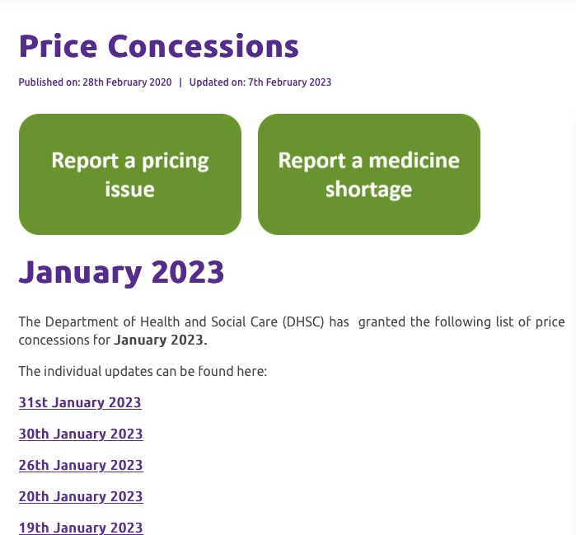
Stock Shortages
psnc.org.uk/funding-and-reimbursement/reimbursement/price-concessions/

Slide 44
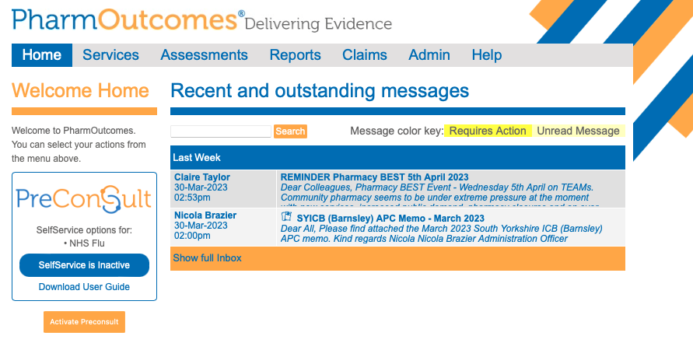

Slide 45
